Slide 1
Walmart
Presented By: Geetha Kandukuri, Camille Jensen, Tim Philippsen, Kevin Denning, Jill Farley

Slide 2
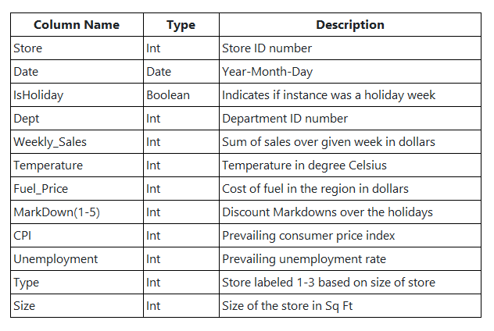
Data Set & Objective
Data Source: Walmart Cleaned Data | Kaggle
Data Requirements
Sales related data to predict potential future revenues
Data over time to learn its trends
Varying attributes that impacts trends
Store Types
Type 1: Walmart Discount Store
Type 2: Walmart Neighborhood Store
Type 3: Walmart Supercenters

Slide 3
Process

Slide 4
Data

Slide 5
Data

Slide 6
Data

Slide 7
Future Predicted Results

Slide 8
Data Limitation
Multiple Year worth of data
February 2010 – October 2012
Sales by Week
Holidays may not fall on the same week number
Holiday outliers

Slide 9
Thank you

